Slide 1

Sprocket Central Pty Ltd
Data analytics approach
Michael Nguyen

Slide 2
Agenda
Introduction
Data Exploration
Model Development
Interpretation

Slide 3
Introduction
New customers analyze:
Look into these factors in new customers:
Age distributions
Number of bike purchases in 3 years / percentages purchases
Job industry category.
Wealth segments
Number of cars own on each states.

Slide 4
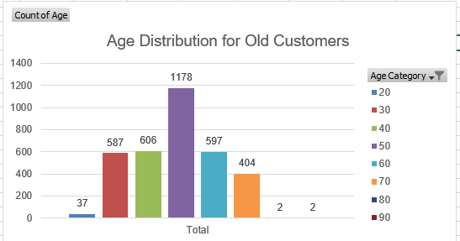
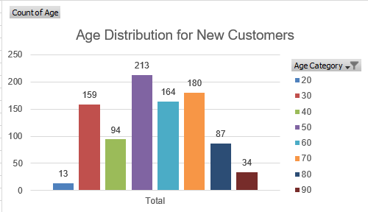
Data Exploration
Customers’ age distribution
The majority of the customers are between 20 to 69 years old for both new and old group.
However, customers from the old group focuses mostly between 40-49 years old, nearly double other age brackets.
The age distribution of new customers are more even between 20-69 (with the exception of 30-39 which witnesses a sharp decline) which suggest customers are more diverse in terms of age.
Additionally, there is also a significant increase of customers between 70 and 89 years old.
20 = under 20, 30 = 20 to 29

Slide 5
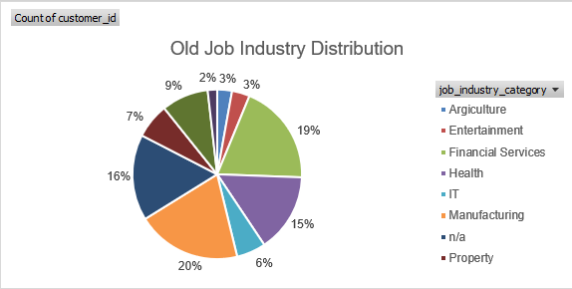
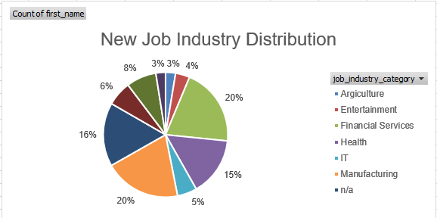
Data Exploration
Job Industry Distribution
Job industry distribution largely remains the same between old and new customer
Around 40% of the customers are in manufacturing and financial services (20% each)
Additionally, 30% of the customers are in health and agriculture industries (15% each)

Slide 6
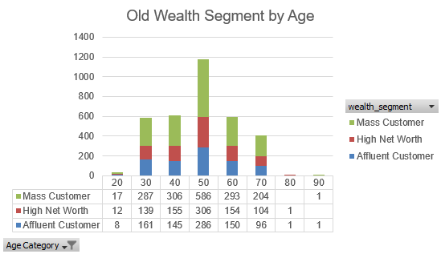
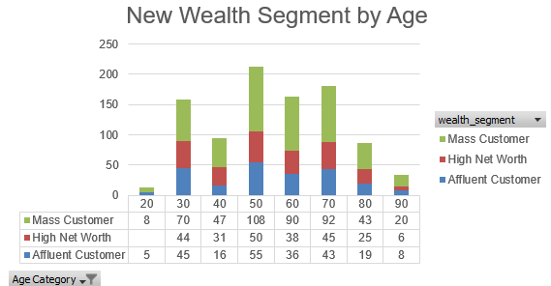
Data Exploration
Wealth Segment by Age Distribution
About half of the customers are Mass Customer for both old and new data
There are more high net worth customers than affluent customers in almost every age bracket (except 20-29 age bracket) for both old and new customers.

Slide 7
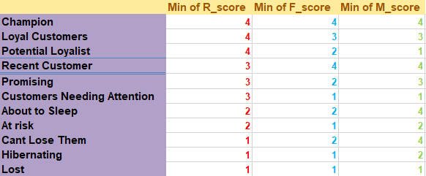
Note: The data and information in this document is reflective of a hypothetical situation and client. This document is to be used for KPMG Virtual Internship purposes only.
Model Development
RFM Analysis and Customer Segmentation
We use RFM analysis to determine which customers the company should target to increase revenue and value
RFM analysis uses the scale 1-4 (with 1 being the lowest) and focuses on 3 category recency, frequency, and monetary.

Slide 8
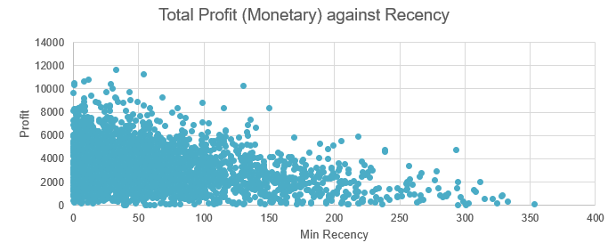
Note: The data and information in this document is reflective of a hypothetical situation and client. This document is to be used for KPMG Virtual Internship purposes only.
Model Development
Scatter plot based on RFM analysis
The plot shows that recent customers generate more value (for historical data), with customer from 0 to 100 days of recency generates the most profit.
Those who visited more than 200 days generates considerably less value.

Slide 9
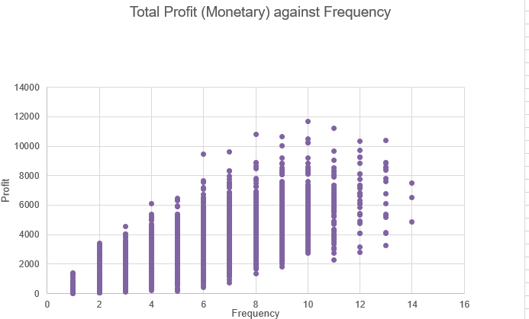
Note: The data and information in this document is reflective of a hypothetical situation and client. This document is to be used for KPMG Virtual Internship purposes only.
Model Development
Scatter plot based on RFM analysis
The graph indicates that customers that has the frequency of 6+ generates the most values.
Hence, there is a positive correlation between frequency and profit for the business

Slide 10
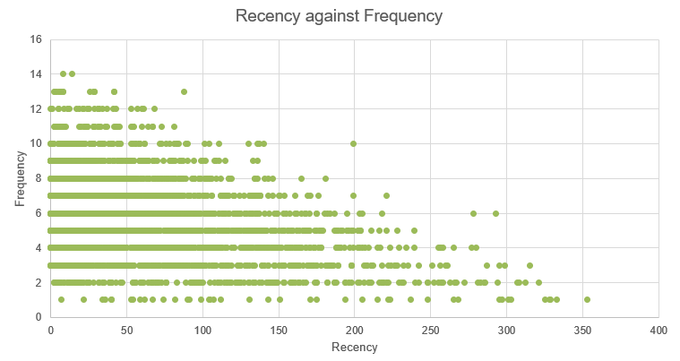
Note: The data and information in this document is reflective of a hypothetical situation and client. This document is to be used for KPMG Virtual Internship purposes only.
Model Development
Scatter plot based on RFM analysis
The graph indicates that customers that has bought more recently (0-100) are likely to have a frequency more than 6
Customers who have bought more than 300 days ago tends to have low frequency (<= 3)
Hence, there is a negative correlation between recency and frequency of customer.

Slide 11
Note: The data and information in this document is reflective of a hypothetical situation and client. This document is to be used for KPMG Virtual Internship purposes only.
Interpretation
Customer Segmentation and Definition
Customer Segment | Definition | RFM score
Champions | Bought recently, most often and spent the most | 444
Loyal Customers | Spent good money often | 433
Potential Loyalist | Recent customers, bought more than once, spend good amount | 422
Recent Customer | Bought most recently, but not often | 421
Promising | Recent shopper but haven’t spent much | 332
Customers Needing Attention | Above average recency, frequency and monetary value | 222
About to Sleep | Below average recency, frequency and monetary | 211
At Risk | Spent big money and purchase often, but long time ago | 123
Cant Lose Them | Made biggest purchase but haven’t return for a long time | 124
Hibernating | Last purchase was long back, low spenders and low orders | 111
Lost | Lowest RFM | 111

Slide 12
Note: The data and information in this document is reflective of a hypothetical situation and client. This document is to be used for KPMG Virtual Internship purposes only.
Interpretation
Customer Distribution

Slide 13
Note: The data and information in this document is reflective of a hypothetical situation and client. This document is to be used for KPMG Virtual Internship purposes only.
Interpretation
Top 1000 Customers to target
Customer Segment | Definition | RFM score | Customer selection
Champions | Bought recently, most often and spent the most | 444 | 208
Loyal Customers | Spent good money often | 433 | 236
Potential Loyalist | Recent customers, bought more than once, spend good amount | 422 | 438
Recent Customer | Bought most recently, but not often | 421 | 144
Promising | Recent shopper but haven’t spent much | 332 | 0
Customers Needing Attention | Above average recency, frequency and monetary value | 222 | 0
About to Sleep | Below average recency, frequency and monetary | 211 | 0
At Risk | Spent big money and purchase often, but long time ago | 123 | 0
Cant Lose Them | Made biggest purchase but haven’t return for a long time | 124 | 0
Hibernating | Last purchase was long back, low spenders and low orders | 111 | 0
Lost | Lowest RFM | 111 | 0
 |  |  | 1026

Slide 14
Note: The data and information in this document is reflective of a hypothetical situation and client. This document is to be used for KPMG Virtual Internship purposes only.
Appendix

